Slide 1
PRAM architectures, algorithms, performance evaluation

Slide 2
Shared Memory model and PRAM
p processors, each may have local memory
  Each processor has index, available to local code
Shared memory
During each time unit, each processor either
  Performs one compute operation, or
  Performs one memory access
    Challenging. Means very good shared memory (maybe small)
Two modes:
  Synchronous: all processors use same clock (PRAM)
  Asynchronous: synchronization is code responsibility
    Asynchronous is more realistic

Slide 3
The other model: Network
Linear, ring, mesh, hypercube
Recall the two key interconnects: FT and Torus

Slide 4
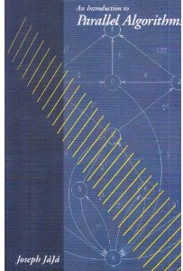
A first glimpse, based on
Joseph F. JaJa, Introduction to Parallel Algorithms, 1992
  www.umiacs.umd.edu/~joseph/
Uzi Vishkin, PRAM concepts (1981-today)
  www.umiacs.umd.edu/~vishkin

Slide 5
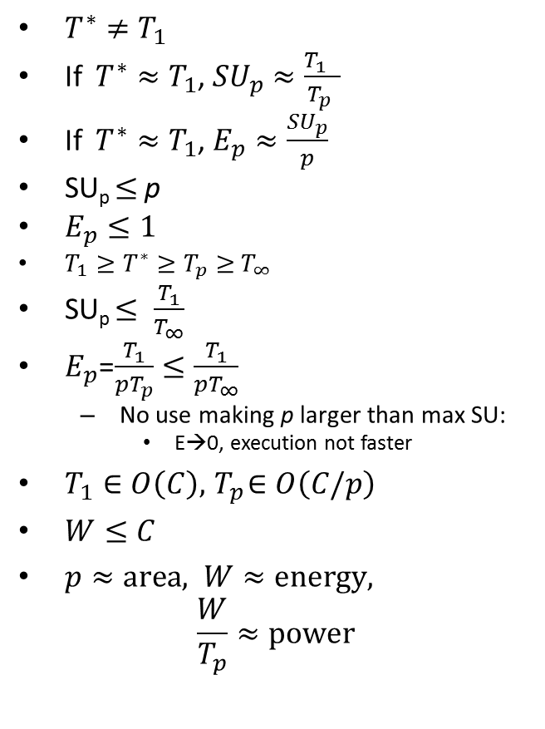
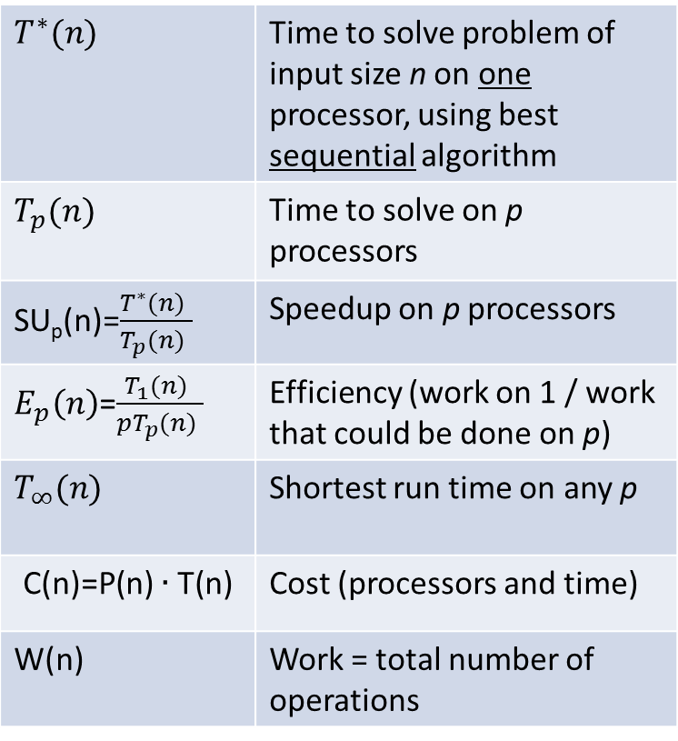
Definitions
$$T^{∗}(n)$$ | Time to solve problem of input size n on one processor, using best sequential algorithm
$$T_{p}(n)$$ | Time to solve on p processors
SU_{p}(n)=$\frac{T^{∗}(n) }{T_{p}(n) }$ | Speedup on p processors
$E_{p}\left(n\right)$=$\frac{T_{1}(n) }{{pT}_{p}(n) }$ | Efficiency (work on 1 / work that could be done on p)
$$T_{∞}(n)$$ | Shortest run time on any p
$$\text{C}\text{(}\text{n}\text{)=}\text{P}\text{(}\text{n}\text{)}∙\text{T}\text{(}\text{n}\text{)}$$ | Cost (processors and time)
W(n) | Work = total number of operations
$T^{∗}≠T_{1}$
If $T^{∗}≈T_{1}$, ${SU}_{p}≈\frac{T_{1} }{T_{p} }$
If $T^{∗}≈T_{1}$, $E_{p}≈\frac{{SU}_{p}}{p}$
SU_{p} $≤$p
$E_{p}≤1$
${T_{1}≥T}^{∗}≥T_{p}≥$ $T_{∞}$
SU_{p} $≤ \frac{T_{1}}{T_{∞}}$
$E_{p}$=$\frac{T_{1}}{{pT}_{p}}≤\frac{T_{1}}{{pT}_{∞}}$
  No use making p larger than max SU:
    E→0, execution not faster
$T_{1}∈O\left(C\right),{ T}_{p}∈O\left(C/p\right)$
$W≤C$
$p≈area, W≈energy,$
$\frac{W}{T_{p}}≈power$

Slide 6
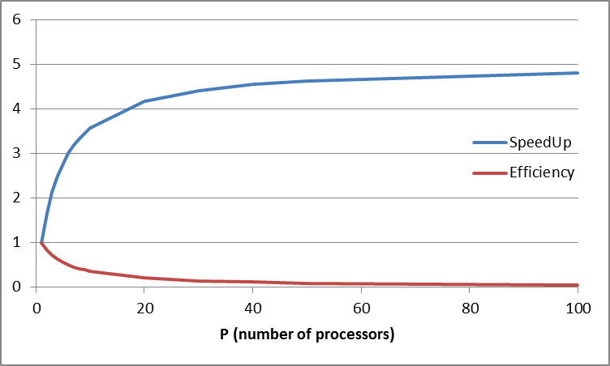
SpeedUp and Efficiency
Warning: This is only a (bad) example: An 80% parallel Amdahl’s law chart.
We’ll see why it’s bad when we analyze (and refute) Amdahl’s law.
Meanwhile, consider only the trend.

Slide 7
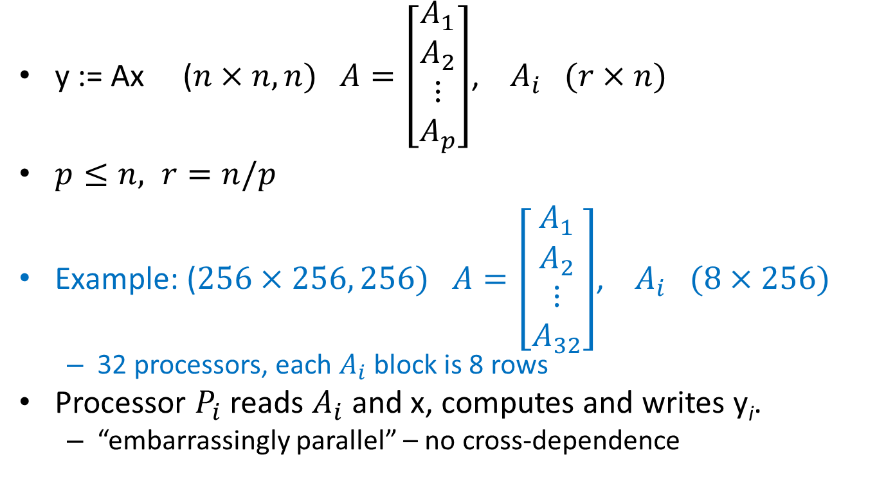
Example 1: Matrix-Vector multiply (Mvm)
y := Ax ($n×n, n)$ $A=\left[\begin{matrix}A_{1} \\ A_{2} \\ \begin{aligned}⋮ \\ A_{p}\end{aligned}\end{matrix}\right]$, $A_{i} (r×n)$
$p≤n, r=n/p$
Example: ($256×256, 256)$ $A=\left[\begin{matrix}A_{1} \\ A_{2} \\ \begin{aligned}⋮ \\ A_{32}\end{aligned}\end{matrix}\right]$, $A_{i} (8×256)$
  32 processors, each $A_{i}$ block is 8 rows
Processor $P_{i}$ reads $A_{i}$ and x, computes and writes y_{i}.
  “embarrassingly parallel” – no cross-dependence

Slide 8
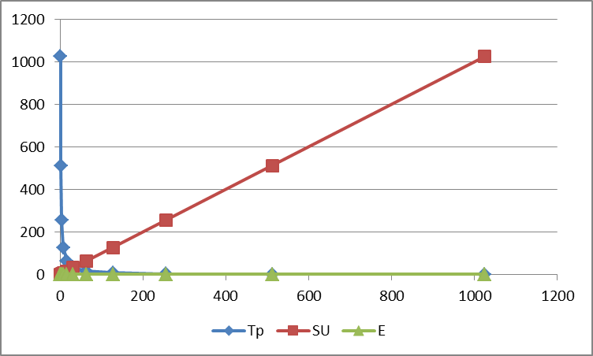
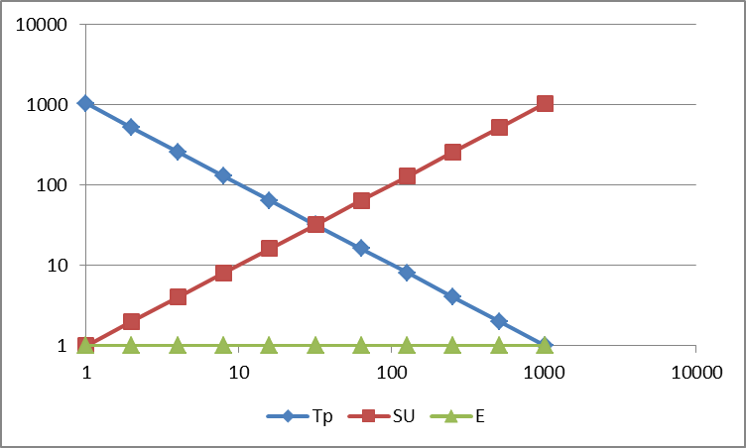
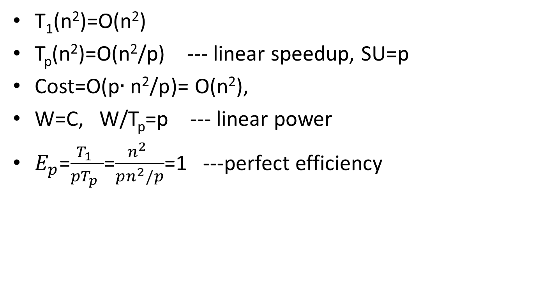
Performance of Mvm
T₁(n²)=O(n²)
T_{p}(n²)=O(n²/p) --- linear speedup, SU=p
Cost=O(p$∙\text{n}\text{2}\text{/}\text{p}$)= O(n²),
W=C, W/T_{p}=p --- linear power
$E_{p}$=$\frac{T_{1} }{{pT}_{p} }$=$\frac{n^{2} }{pn^{2}/p}$=1 ---perfect efficiency
lin
log
n²=1024
p
p
We use log-log charts
log

Slide 9
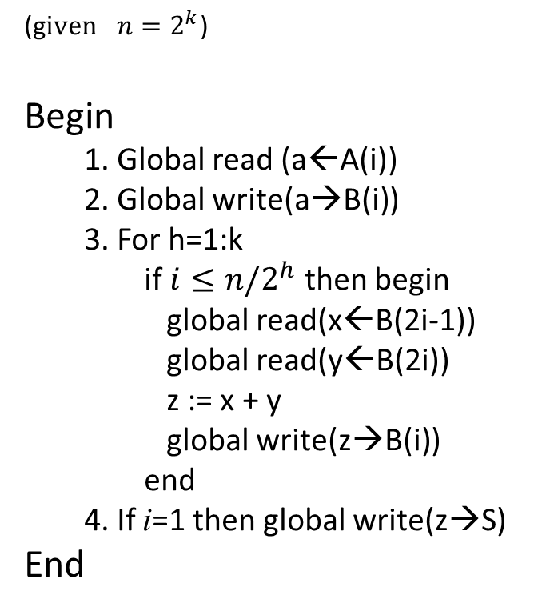
Example 2: SPMD Sum A(1:n) on PRAM
SPMD? MIMD? SIMD?
(g$iven n=2^{k}$)
Begin
  1. Global read (a←A(i))
  2. Global write(a→B(i))
  3. For h=1:k
  if $i≤n/2^{h}$ then begin
  global read(x←B(2i-1))
  global read(y←B(2i))
  z := x + y
  global write(z→B(i))
  end
  4. If i=1 then global write(z→S)
End
h | i | adding
1 | 1 | 1,2
 | 2 | 3,4
 | 3 | 5,6
 | 4 | 7,8
2 | 1 | 1,2
 | 2 | 3,4
3 | 1 | 1,2

Slide 10

Logarithmic sum
The PRAM algorithm
// Sum vector A(*)
Begin
  B(i) := A(i)
  For h=1:log(n)
  if $i≤n/2^{h}$ then
  B(i) = B(2i-1) + B(2i)
End
// B(1) holds the sum
h=3
h=2
h=1
a₁
a₂
a₃
a₄
a₅
a₆
a₇
a₈

Slide 11
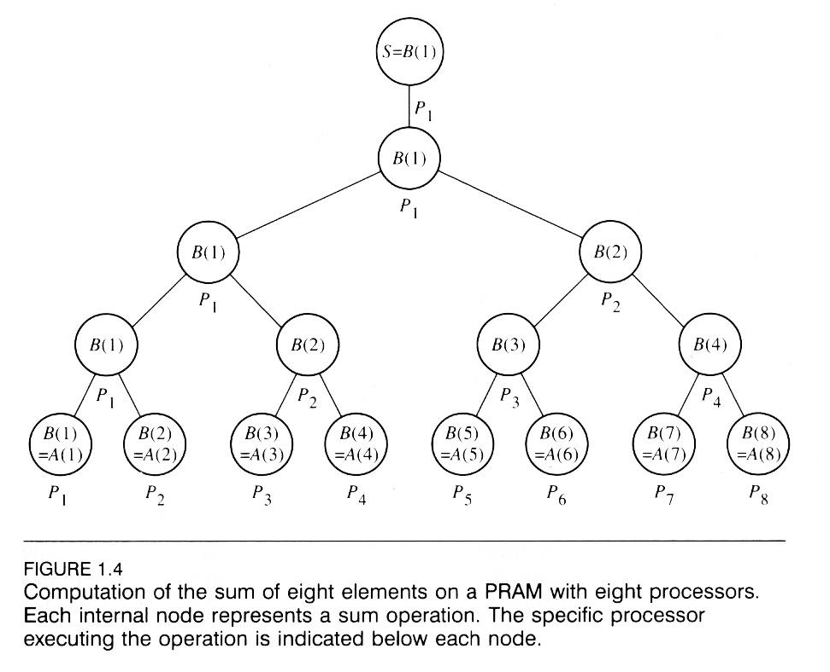

Slide 12
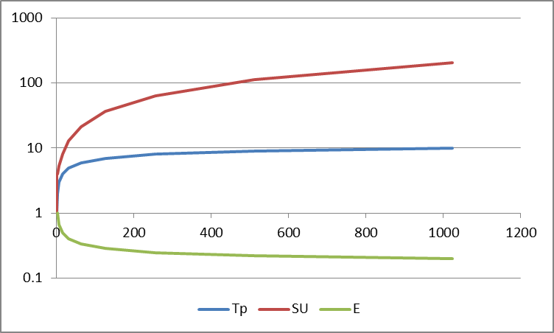
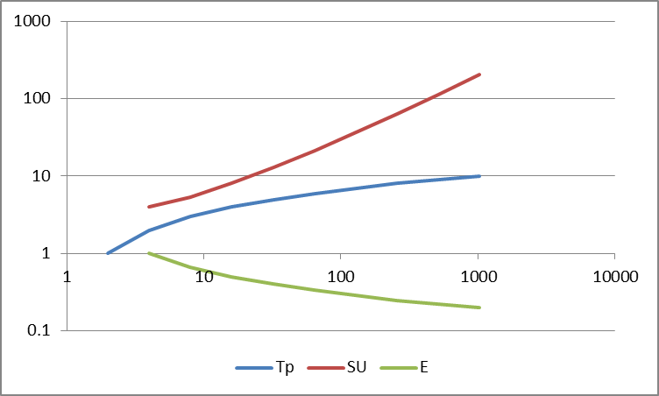

Performance of Sum (p=n)
T*(n)=T₁(n)=n
T_{p=n}(n)=2+log n
SU_{p}=$\frac{n }{2+log n}$
Cost=p$∙$ (2+log n)≈n log n
$E_{p}$=$\frac{T_{1} }{{pT}_{p}}$=$\frac{n }{n log n}$=$\frac{1}{log n}$
p=n
log-log chart
p=n
Speedup and efficiency decrease

Slide 13
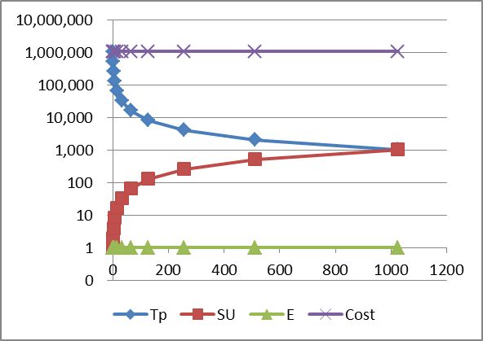
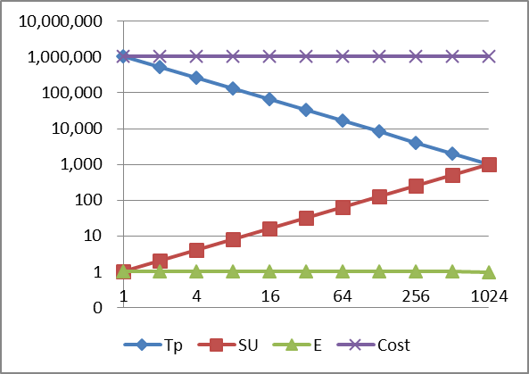

Performance of Sum (n>>p)
n=1,000,000
T*(n)=T₁(n)=n
$T_{p}\left(n\right)=\frac{n}{p}+\log{p}$
SU_{p}=$\frac{n }{\frac{n}{p}+log p}$≈p
Cost=$p\left(\frac{n}{p}+\log{p}\right)$ ≈n
Work = n+p ≈n
$E_{p}$=$\frac{T_{1} }{{pT}_{p}}$=$\frac{n }{p\left(\frac{n}{p}+\log{p}\right)}$≈1
p
log-log chart
Speedup & power are linear
Cost is fixed
Efficiency is 1 (max)

Slide 14
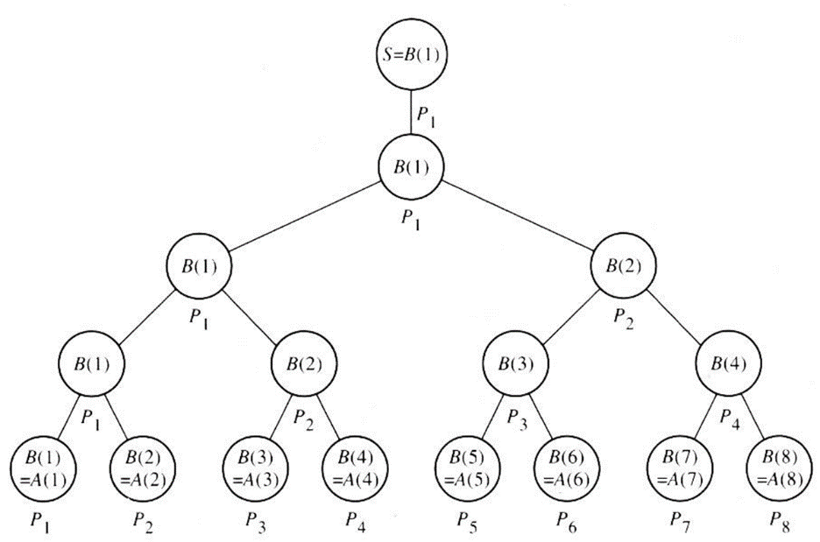
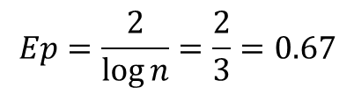
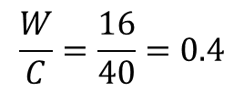
Work doing Sum
T₈ = 5
1
C = 8⋅5 = 40 -- could do 40 steps
1
W = 2n = 16 -- 16/40, wasted 24
$$Ep=\frac{2}{\log{n}}=\frac{2}{3}=0.67$$
2
4
$$\frac{W}{C}=\frac{16}{40}=0.4$$
8
Work =
16

Slide 15
Which PRAM?
Namely, how does it write?
Exclusive Read Exclusive Write (EREW)
Concurrent Read Exclusive Write (CREW)
Concurrent Read Concurrent Write (CRCW)
  Common: concurrent only if same value
  Arbitrary: one succeeds, others ignored
  Priority: minimum index succeeds
Computational power: EREW < CREW < CRCW

Slide 16
Simplifying pseudo-code
Replace
    global read(x←B)
    global read(y←C)
    z := x + y
    global write(z→A)
By
  A := B + C ---A,B,C shared variables

Slide 17
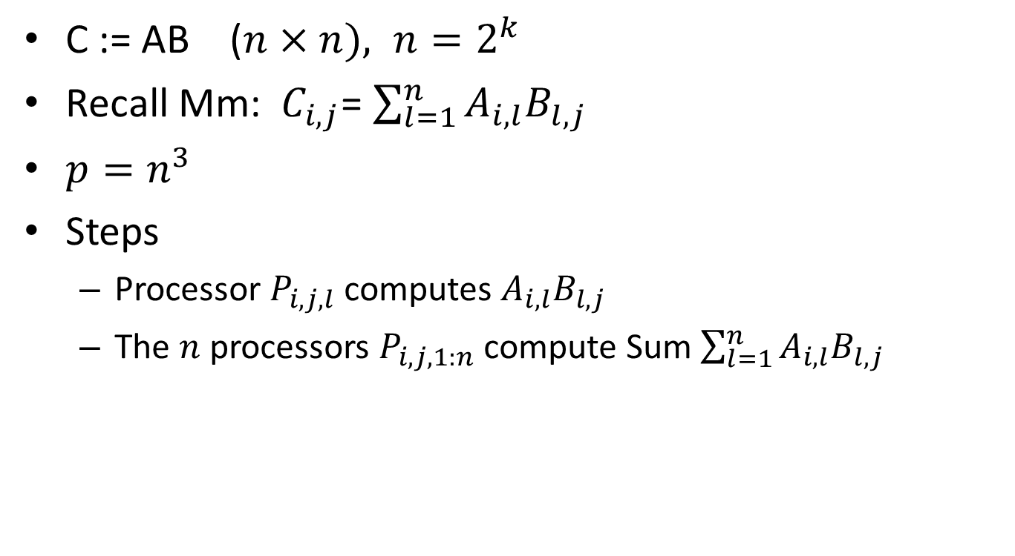
Example 3: Matrix multiply on PRAM
C := AB ($n×n), n=2^{k}$
Recall Mm: $C_{i,j}$= $\sum_{l=1}^{n}{A_{i,l}B_{l,j}}$
$p=n^{3}$
Steps
  Processor $P_{i,j,l}$ computes $A_{i,l}B_{l,j}$
  The $n$ processors $P_{i,j,1:n}$ compute Sum $\sum_{l=1}^{n}{A_{i,l}B_{l,j}}$
=
×

Slide 18
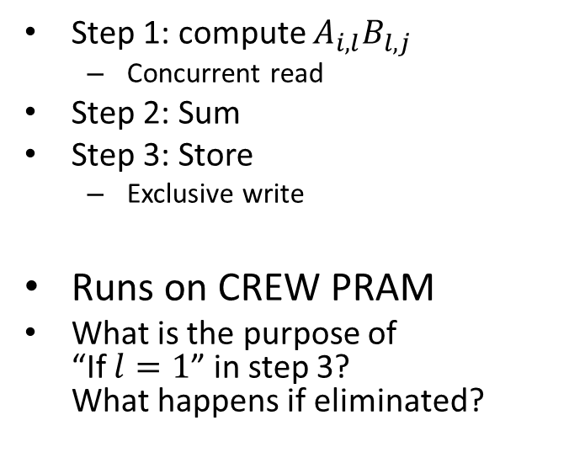
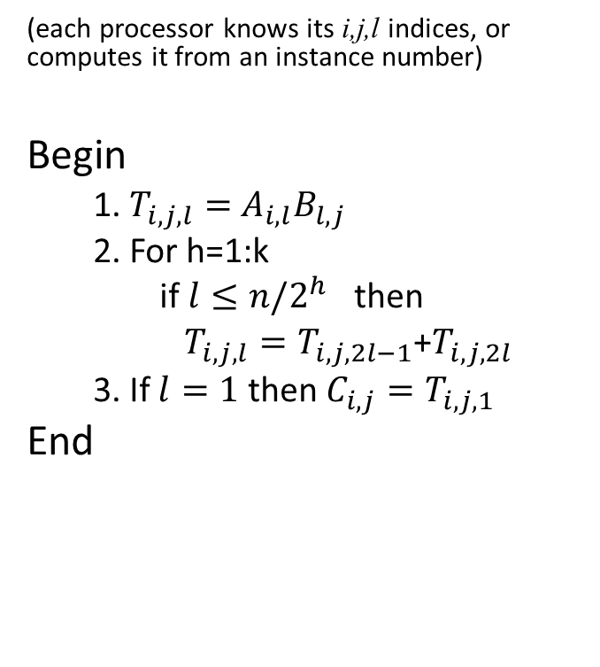
Mm Algorithm
(each processor knows its i,j,l indices, or computes it from an instance number)
Begin
  1. $T_{i,j,l}=$ $A_{i,l}B_{l,j}$
  2. For h=1:k
  if $l≤n/2^{h}$ then
  $T_{i,j,l}=T_{i,j,2l−1}$+$T_{i,j,2l}$
  3. If $l=1$ then $C_{i,j}=T_{i,j, 1}$
End
Step 1: compute $A_{i,l}B_{l,j}$
  Concurrent read
Step 2: Sum
Step 3: Store
  Exclusive write
Runs on CREW PRAM
What is the purpose of
“If $l=1$” in step 3?
What happens if eliminated?

Slide 19
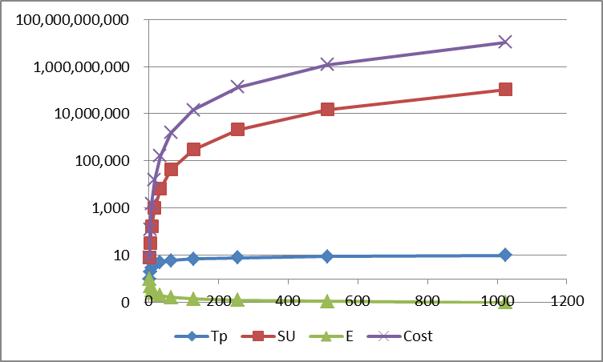
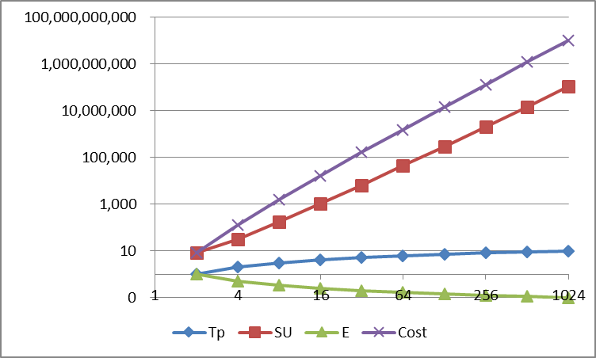

Performance of Mm
$T_{1}=n^{3}$
$T_{p=n^{3}}=\log{n}$
$SU=\frac{n^{3}}{\log{n}}$
$Cost=n^{3} log{n}$
$E_{p}$=$\frac{T_{1} }{{pT}_{p} }$=$\frac{1 }{\log{n}}$
log-log chart

Slide 20

Prefix Sum
Take advantage of idle processors in Sum
Compute all prefix sums $S_{i}=\sum_{1}^{i}{a_{j}}$
  $a_{1},{ a}_{1}+a_{2}, a_{1}+a_{2}+a_{3}, …$

Slide 21
Prefix Sum on CREW PARM
s₁
s₂
s₃
s₄
s₅
s₆
s₇
s₈
CR
CR
CR
a₁
a₂
a₃
a₄
a₅
a₆
a₇
a₈
HW3: Write this as a PRAM algorithm (due May 6 2012)

Slide 22
Is PRAM implementable?
Can be an ideal model for theoretical algorithms
  Algorithms may be converted to real machine models (XMT, Plural, Tilera, …)
Or can be implemented ‘directly’
  Concurrent read by detect-and-multicast
    Like the Plural P2M net
    Like the XMT read-only buffers
  Concurrent write how?
    Fetch & Op: serializing write
    Prefix-sum (f&a) on XMT: serializing write
    Common CRCW: detect-and-merge
    Priority CRCW: detect-and-prioritize
    Arbitrary CRCW: arbitrarily…

Slide 23
Common CRCW example 1: DNF
Boolean DNF (sum of products)
  X = a₁b₁ + a₂b₂ + a₃b₃ + … (AND, OR operations)
  PRAM code (X initialized to 0, task index=$) :
  if (a$b$) X=1;
  Common output:
    Not all processors write X.
    Those that do, write 1.
  Time O(1)
  Great for other associative operators
    e.g. (a₁+b₁)(a₂+b₂).. OR/AND (CNF):
    init X=1, if NOT(a$+b$) X=0;
  Works on common / priority / arbitrary CRCW

Slide 24
Common CRCW example 2: Transitive Closure
The transitive closure G* of a directed graph G may be computed by matrix multiply
  B adjacency matrix
  B^{k} shows paths of exactly k steps
  (B+I)^{k} shows paths of 1,2,…,k steps
  Compute (B+I)^{|V|-1} in log(|V|) steps
    how?
  Boolean matrix multiply (and, or) shows only existence of paths
    Normal multiply counts number of paths
  |V|=n, |B|=n×n
 | P | W | T
Matrix Multiply | n³ | n³ | 1
Transitive Closure | n³ | n³ log n | log n
Joseph F. JaJa, Introduction to Parallel Algorithms, 1992, Ch. 5

Slide 25
Arbitrary CRCW example: Connectivity
Serial algorithm for connected components:
  for each vertex v∈V MakeSet(v)
  for each edge (u,v)∈E // arbitrary order
    If (Set(u) ≠ Set(v))
    Union(Set(u),Set(v)) // arbitrary union
Parallel:
  Processor per edge
  set(v) is shared variable
  Each set is named after one of the nodes it includes
  Union selects the lower available index
    P(b): set(8)=2
    P(c): set(8)=3
  No problem! Arbitrary CRCW selects arbitrarily
1
a
2
b
8
c
3

Slide 26
Arbitrary CRCW example: Connectivity
1
a
2
b
8
c
3
T | P(a) | P(b) | P(c) | set(1) | set(2) | set(8) | set(3)
0 |  |  |  | 1 | 2 | 8 | 3
1 | set(2)=1 | set(8)=2 | set(8)=3
 |  |  |  | 1 | 1 | 2 | 3
2 |  | set(8)=1 | set(3)=2
 |  |  |  | 1 | 1 | 1 | 2
3 |  |  | set(3)=1
 |  |  |  | 1 | 1 | 1 | 1
Try also with a different arbitrary result

Slide 27
Why PRAM?
Large body of algorithms
Easy to think about
Sync version of shared memory → eliminates sync and comm issues, allows focus on algorithms
  But allows adding these issues
  Allows conversion to async versions
Exist architectures for both
  sync (PRAM) model
  async (SM) model
PRAM algorithms can be mapped to other models

