Slide 1
XMT
Another PRAM Architectures

Slide 2
Two PRAM Architectures
XMT: PRAM-on-Chip, by Uzi Vishkin lab
  www.umiacs.umd.edu/~vishkin/XMT
Plural Architecture (our own)

Slide 3
F&A→PS→XMT
Fetch and Add instruction
  From NYU Ultracomputer
    Gottlieb, Grishman, Kruskal, McAuliffe, Rudolph and Snir, “The NYU Ultracomputer - designing an MIMD shared memory parallel computer,” IEEE Trans. Computers, 32(2):175–189, 1983
Variants: F&Op, F&Incr.
F&I useful to create a list of mutex indices
Parallel execution of F&I is best by prefix-sum

Slide 4
Fetch & Add
A=20 shared variable
P_{i} : x=faa(A,+2)
P_{k} : x=faa(A,+5)
Convergence node in MIN: {faa(A,+2),faa(A,+5)}→faa(A,+7)
Pi
P
P
P
Pk
+2
+5
MIN
+7
M
M
20
M
M
A
MIN=Multistage Interconnection Network (logarithmic, e.g. delta or omega networks)

Slide 5
Fetch & Add
A=20 shared variable
P_{i} : x=faa(A,+2)
P_{k} : x=faa(A,+5)
Convergence node in MIN: {faa(A,+2),faa(A,+5)}→faa(A,+7)
A← 20+7=27, but returns 20
MIN node decides arbitrarily that P_{k} came first
P_{j} : x ← 25
P_{k} : x ← 20
Pi
P
P
P
Pk
+25
+20
MIN
20
M
M
27
M
M
A

Slide 6
Fetch & Increment
All p processors (or subset) execute indx=f&i(B)
  Same as faa(B,+1)
They are assigned the values 0:p-1 in arbitrary order
Same result as prefix sum of an array of all-ones
Takes O(log p) time
This could be used by PRAM algorithms
P
P
P
P
P
M
M
0
M
M
B

Slide 7
Prefix-Sum Hardware
ps hardware dedicated to parallel (synchronized) execution of F&I
Can support any subset of processors
Eliminates need for F&A smart network to main memories
  Enables simple cache interfaces
Prefix Sum
ps Network
P
P
P
P
P
MIN
M
M
M
M
M

Slide 8
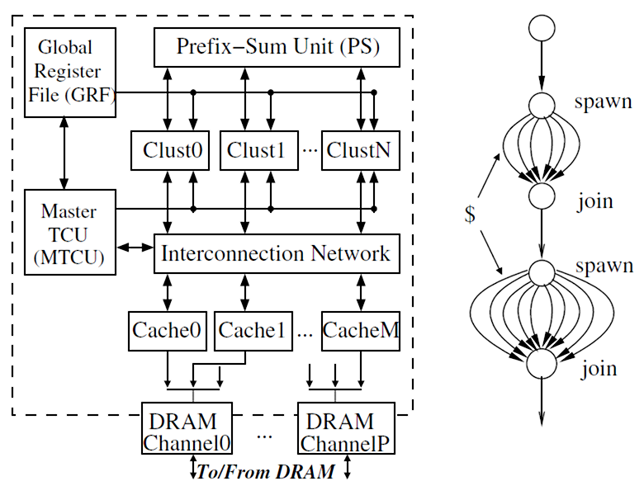
Simple XMT architecture

Slide 9
XMT architecture
X. Wen and U. Vishkin. FPGA-based Prototype of a PRAM-On-Chip Processor. ACM-CF’08: Computing Frontiers, pp. 55–66, 2008

Slide 10
Example: Vector compact
Vector A contains many 0’s
Wish to compact it to vector B with no 0’s
Explicit spawn for A(0:n-1)
If non-zero,
  request unique index to B
  write into B

Slide 11
How XMT manages parallelism
Explicit spawn (and join)
  Can generate n >> p threads
  Execution is NOT synchronized (unlike PRAM)
  Execution of thread can happen in any order (e.g. p=1)
Each processor loops:
  Executes ps(…) to receive a thread ID
  Executes that thread
Data on shared memory, code broadcast
“processors” are actually Thread Control Units
  Functional units shared via network
Clustering confuses the picture
  Need to split thread IDs into groups (for clusters)
    By means of PS bounds
  Need to synchronize the clusters

Slide 12
The XMT cluster

Slide 13
How XMT manages memory access
LS hash unit hashes addresses
  Uniform spread
  Map large space to small
Where is the cache? global

Slide 14
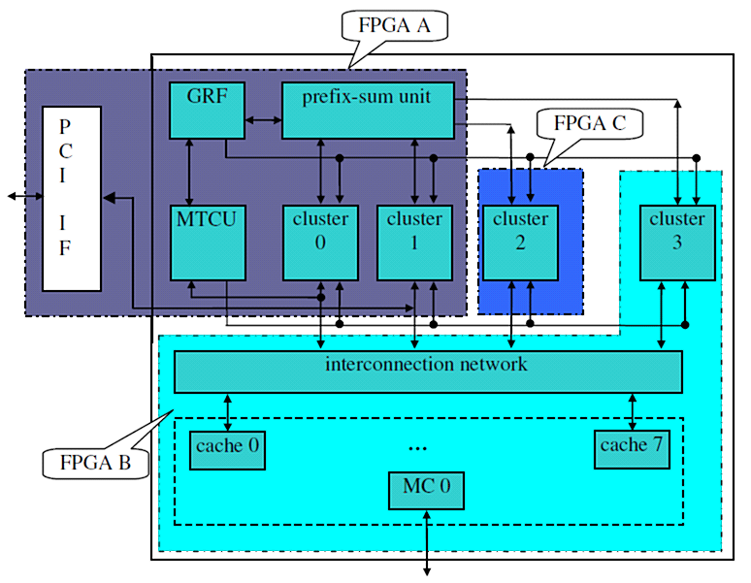
XMT prototype on 3 FPGAs

Slide 15
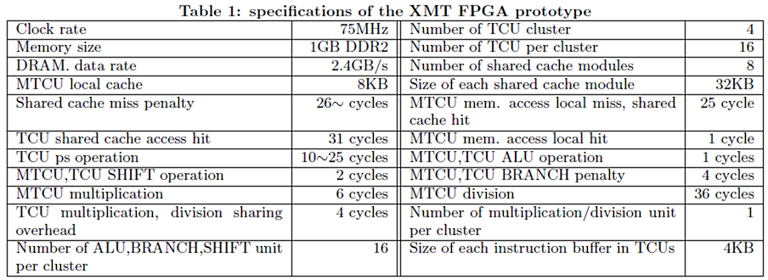
XMT on FPGA tested
64 processors

Slide 16
Benchmark

Slide 17
SU, hit rate
Max SU = 64. Memory-bound and memory-irregular apps: low SU.

Slide 18
Exec time comparisons

